Slide 1
STRATA
Open Source Market Risk

Slide 2
STEPHEN COLEBOURNE
Java Champion, regular conference speaker
Best known for date & time - Joda-Time and JSR-310
More Joda projects - http://www.joda.org
Major contributions in Apache Commons
Blog - http://blog.joda.org
Worked at OpenGamma for 6 years

Slide 3
OPENGAMMA
Founded in 2009
Financed by Venture Capital
Mission to bring Open Source values to finance industry
Focus on Market Risk Analytics and Market Structure

Slide 4
MARKET RISK

Slide 5
MARKET RISK
Providing pricing and analytics on a financial portfolio
“present value (NPV) of an interest rate swap”
“PV01 of a forward rate agreement (FRA)”
“vega and gamma of an FX vanilla option”
“examine the portfolio against a set of scenarios”

Slide 6
COMPONENTS FOR MARKET RISK
Pricing/Analytic models
Trade representations - for each supported asset class
Market data representations - quotes, curves, surfaces, etc.
Calibration - curves, surfaces, etc.
Market data management and Scenario creation
Reference data - holiday calendars, securities
Basics - schedules, day counts, currencies, etc.

Slide 7
BUILD, BUY OR OPEN SOURCE?
Build it in-house
Buy from a vendor
Open Source
QuantLib (C++, with exports to other languages)
Strata (Java/JVM)

Slide 8
STRATA

Slide 9
OVERVIEW
Open Source - Apache v2 license
Lightweight, easy-to-use library
Just jar files - no servers or databases needed
Released in Maven Central
Foundation for OpenGamma commercial products

Slide 10
Reporting
Simple, yet powerful, reporting facilities
Report templates
Measures
Calculation API, scenarios, job execution
Calc functions
Measures
Pricers
Pricing &
Analytics
Built-in pricers
Sensitivities
Curve framework
Interpolators
Market
Data
Market Data API
Data sourcing
Scenarios
Live data providers
Market data types
Perturbations
Filters
Trade Model
Products, trades, securities
Data Mgmt
Asset classes
Data sources
Loaders
Source integration
Config types
Currencies
Business day conventions, currencies, day counts, holidays, identifiers, indices, roll conventions, time-series
Holiday calendars
Commons
Indices
Day counts

Slide 11
QUICK START
Built in examples
Up and running in minutes
Hard coded reference data
Holidays, indices, conventions
Simple command line reporting

Slide 12
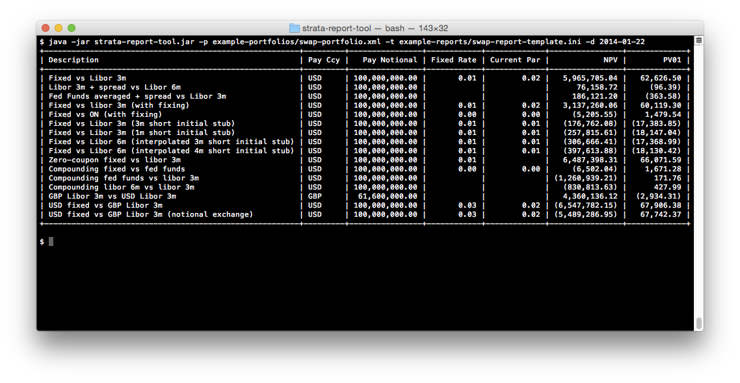

Slide 13
JAVA 8
Early decision to use Java 8 for Strata
Features very beneficial for Market Risk Analytics
Date and Time
Streams and Lambdas
Methods on interfaces
Affects both macro-level design and micro-level code

Slide 14
DEPENDENCIES
Guava
Joda-Beans
Joda-Convert
SLF4J
Commons-Math
Colt

Slide 15
MODULES
strata-collect - low-level, arrays, time-series, IO, tuples
strata-basics - holidays, schedules, indices, reference data
strata-data - market data containers
strata-market - market data structures - curves, surfaces, etc
strata-product - trades, products, securities
strata-loader - data loaders from csv and xml
strata-pricer - analytic pricers
strata-calc - calculation engine, scenarios, market data building
strata-measure - high-level measures, potentially multi-scenario

Slide 16
TRADES

Slide 17
TRADES
Trades are simple immutable beans (data objects)
Built using Joda-Beans
Use builder or static factory to create
Real properties and methods with Javadoc

Slide 18
JODA-BEANS
Source code generator/regenerator
Just write the fields and add a couple of annotations
Joda-Beans generates additional high-quality source code
Mutable and immutable beans
Provides C# style properties

Slide 19
TRADES AND PRODUCTS
Trade
Trade date
Trade identifier
Counterparty
Product
Financial details of the trade
Effective/Termination date, notional, rate, index, etc.

Slide 20
TRADES AND PRODUCTS
Trade
ProductTrade
Product
FraTrade
Fra

Slide 21
FRA
// create Fra using builder
Fra fra = Fra.builder()
.buySell(BuySell.BUY) // Buy
.index(IborIndices.GBP_LIBOR_3M) // GBP LIBOR 3M
.notional(10_000_000) // 10 million GBP
.fixedRate(0.0085) // 0.85%
.startDate(LocalDate.of(2016, 9, 14))
.endDate(LocalDate.of(2016, 12, 14))
.build();

Slide 22
FRA
// create FraTrade
Fra fra = ...
TradeInfo info = TradeInfo.builder()
.tradeDate(LocalDate.of(2016, 6, 14))
.id(StandardId.of(“Trade”, “123456”))
.counterparty(StandardId.of(“Party”, “654321”))
.build();
FraTrade trade = FraTrade.of(info, fra);

Slide 23
CONVENTIONS
Most OTC trades follow market conventions
Strata includes definitions of some of these conventions
Avoids repetitive code

Slide 24
FRA CONVENTION
// create FRA from a convention
FraTrade trade =
FraConvention.of(IborIndices.GBP_LIBOR_3M)
.createTrade(
LocalDate.of(2015, 7, 14), // Trade date
Period.ofMonths(2), // start in 2 months
BuySell.BUY, // Buy
10_000_000, // 10 million GBP
0.012, // 1.2%
ReferenceData.standard()); // Holiday calendars

Slide 25
SWAP
Flexible interest rate swap
Fixed legs support variable interest rates and known amounts
Float legs support Ibor, Overnight and Inflation
Stubs support fixed, floating, interpolated and known amount
Support for variable notional, gearing and spread
Conventions and Templates available

Slide 26
SWAP
Trade
ProductTrade
Product
SwapTrade
Swap

Slide 27
Swap
SwapLeg
PeriodicSchedule
PaymentSchedule
RateCalculation
SwapLeg
NotionalSchedule
RateCalculation
Fixed
RateCalculation
Ibor
RateCalculation
Overnight
RateCalculation
Inflation
RateCalculation

Slide 28
SWAP
// create swap from a convention
SwapTrade trade =
FixedIborSwapConventions.GBP_FIXED_1Y_LIBOR_3M
.createTrade(
LocalDate.of(2015, 7, 14), // Trade date
Tenor.TENOR_10Y, // 10 year swap
BuySell.BUY, // Buy
10_000_000, // 10 million GBP
0.014, // 1.4%
ReferenceData.standard()); // Holiday calendars

Slide 29
SECURITIES
Two approaches supported
Define security as and when needed
Setup reference data map of securities
Provides ability to use, or avoid, a big security master

Slide 30
SECURITIES AS PRODUCTS
Trade
ProductTrade
Product
IborFutureOption
Trade
IborFutureOption
IborFuture

Slide 31
SECURITIES AS REFERENCE DATA
Trade
Security
SecurityTrade
IborFutureOption
Security
IborFuture
Security
ReferenceData used to lookup SecurityId
IborFutureOption
IborFuture

Slide 32
ASSET CLASSES
Swaps, Swaptions, DSF, CMS, Cap/Floor
FRA, STIR futures, STIR future options
Bond, Bond futures, Bond future options
FX forward, NDF, FX swap, vanilla option, single barrier option
CDS
Term deposit, Bullet payment

Slide 33
PRICERS

Slide 34
PRICERS
Lower-level analytics API
Provides ability to calculate PV, sensitivities, greeks, etc.
Explain facility to understand how result was calculated
Operates on resolved trades/products

Slide 35
RESOLVING
Resolving the trade requires reference data
Locks in dates to the current holiday calendar rules
Standard reference data contains hard coded holiday rules
// resolve a swap
SwapTrade trade = …
ReferenceData refData = ReferenceData.standard();
ResolvedSwapTrade resolved = trade.resolve(refData);

Slide 36
RESOLVING
SwapTrade
Swap
SwapLeg
Trade resolved using
ReferenceData
Resolved leg contains full list of accrual/payment periods, stubs and notional exchange
Resolved
SwapTrade
Resolved
Swap
Resolved
SwapLeg

Slide 37
USING A PRICER
Stateless - takes resolved trade and any necessary market data
Calculates for one trade and one set of market data
Can usually price at trade or product level

Slide 38
USING A PRICER
// obtain the swap and market data to price against
ResolvedSwapTrade trade = ...
RatesProvider market = ...
// calculate the present value
MultiCurrencyAmount pv =
DiscountingSwapTradePricer.DEFAULT
.presentValue(trade, market);

Slide 39
MARKET DATA

Slide 40
MARKET DATA
Support for all kinds of market data
Built in classes for FX, quotes, curves, surfaces, etc.
Many types can be loaded from CSV
Multi-curve rates calibration
Scenarios, stored efficiently as arrays

Slide 41
RATES PROVIDER
RatesProvider is a single, coherent, set of market data
FX rates, Discount factors, Ibor rates
Overnight rates, Inflation price indices, Historic fixings
// get discount factors for GBP
DiscountFactors df = ratesProvider.discountFactors(GBP);
double factor = df.discountFactor(date);

Slide 42
MARKET DATA
MarketData is a container of market data
Hash-map like
Keys are MarketDataId<T>
// get curve by identifier
CurveId id = CurveId.of(“Default”, “USD-DSC”);
Curve curve = marketData.getValue(id);

Slide 43
SCENARIO MARKET DATA
ScenarioMarketData is a container of scenario data
Hash-map like, where values are arrays
Keys are MarketDataId<T>
// get curves by identifier
CurveId id = CurveId.of(“Default”, “USD-DSC”);
MarketDataBox<Curve> curves = scenarioData.getValue(id);
// process using a stream (for example)
curves.stream().forEach( curve -> … );

Slide 44
MARKET DATA LOOKUP
Market data containers hold arbitrary sets of market data
May hold multiple USD discounting curves
RatesMarketDataLookup is used to select a coherent set
CurveId usdDscId = CurveId.of(“Default”, “USD-DSC”);
CurveId usdLiborId = CurveId.of(“Default”, “USD-LIBOR”);
// map currency/index to curve
RatesMarketDataLookup md = RatesMarketDataLookup.of(
ImmutableMap.of(Currency.USD, usdDscId),
ImmutableMap.of(
IborIndices.USD_LIBOR_3M, usdLiborId),
IborIndices.USD_LIBOR_6M, usdLiborId));

Slide 45
COMBINATIONS
MarketData
+
RatesMarketDataLookup
=
RatesProvider
• Many curves
• Keyed by curve ID
• Map currency to curve ID
• Map index to curve ID
• DF by currency+date
• Rate by index+date

Slide 46
MARKET DATA BUILDING
Can create market data manually, loading from CSV or by factory
MarketDataFactory can
Query quotes from a simple provider interface
Query time-series from a simple provider interface
Calibrate
Create scenarios by shifting/bumping
See SwapPricingWithCalibrationExample

Slide 47
MEASURES

Slide 48
MEASURE-LEVEL API
Higher-level than pricers
Stateless - takes resolved trade and any necessary market data
Calculates for one trade and one or more sets of market data
ie. supports scenarios
Only operates on trades, not products
Scaled output
eg. PV01 in basis points

Slide 49
USING THE MEASURE-LEVEL API
// obtain the swap and market data to price against
ResolvedSwapTrade trade = ...
RatesProvider market = ...
// calculate the present value
MultiCurrencyAmount pv =
SwapTradeCalculations.DEFAULT
.presentValue(trade, market);

Slide 50
USING THE MEASURE-LEVEL API
// obtain the swap and market data to price against
ResolvedSwapTrade trade = ...
RatesMarketDataLookup lookup = ...
ScenarioMarketData market = ...
// calculate the present value for many scenarios
MultiCurrencyScenarioArray scenarioPv =
SwapTradeCalculations.DEFAULT
.presentValue(trade, lookup, market);

Slide 51
CALCULATIONS

Slide 52
CALCULATION-LEVEL API
Highest-level API
Calculates for many trades and one or more sets of market data
ie. supports scenarios
Optional currency conversion
Multi-threaded
Results can be received asynchronously

Slide 53
CALCULATION-LEVEL API
Calculation API result is a grid
Rows are trades, positions, or similar
Columns are measures, such as PV, PV01, Par rate
Mixed portfolio of trades (PV for Swap, FRA and future in one call)
 | NPV (USD) | NPV (GBP) | PV01 (USD) | Par rate
Trade 1 - Swap | 13,487.25 | 10,176.72 | 12.7365 | 0.23
Trade 2 - Swap | -34,276.73 | -27,273.28 | 76.2725 | 0.24
Trade 3 - FRA | 12,835.26 | 9,263.75 | -26.8367 | 0.31
Trade 4 - STIR | -965.76 | -754.23 | 1.2676 | 0.52

Slide 54
CALCULATIONS
CalculationRunner is entry to Calculation API
Provides a multi-threaded executor
Also allow callers to use their own executor
// obtains a multithreaded runner
try (CalculationRunner runner =
CalculationRunner.ofMultiThreaded()) {
// use the runner
}

Slide 55
RULES
CalculationRules defines how to calculate
Functions mapping from trade type to code
Reporting currency
Market data lookup
// setup the rules
CalculationRules rules = CalculationRules.of(
StandardComponents.calculationFunctions(),
Currency.USD,
ratesMarketDataLookup);

Slide 56
CALCULATIONS
Each column defined by Column
Measure specifies what to calculate
Can control reporting currency per column
// specify the columns
List<Column> columns = ImmutableList.of(
Column.of(Measure.PRESENT_VALUE),
Column.of(Measure.PRESENT_VALUE, Currency.GBP),
Column.of(Measure.PV01_CALIBRATED_SUM),
Column.of(Measure.PAR_RATE));

Slide 57
CALCULATIONS
Calculation runner is stateless
Pass in all inputs, get back results
Separate API allows results to be received asynchronously
// calculate the results
Results results = runner.calculate(
rules, // How to calculate
trades, // Trades to process
columns, // Columns, eg PV, PV01, par rate
marketData, // Market data
referenceData); // Reference data

Slide 58
CALCULATION-LEVEL API
 | NPV (USD) | NPV (GBP) | PV01 (USD) | Par rate
Trade 1 - Swap | 13,487.25 | 10,176.72 | 12.7365 | 0.23
Trade 2 - Swap | -34,276.73 | -27,273.28 | 76.2725 | 0.24
Trade 3 - FRA | 12,835.26 | 9,263.75 | -26.8367 | 0.31
Trade 4 - STIR | -965.76 | -754.23 | 1.2676 | 0.52
... | ... | ... | ... | ...

Slide 59
SUMMARY

Slide 60
STRATA v1.0
Trades are immutable beans
Pricing/risk logic is stateless, and separate from the trades
Three levels of pricing/risk API
Pricer - one trade, one set of market data
Measure - one trade, one or many sets of market data
Calc - many trades, one or many sets of market data

Slide 61
STRATA v1.0
Modern market risk library in Java 8
Lightweight and easy-to-use, lots of examples
Good asset class coverage
Open source, Apache v2 license
Commercial support available from OpenGamma
http://strata.opengamma.io/

Slide 62
THANK YOU

